Slide 1


Finding a serial killer, Homicide reports in the USA 1980 – 2014
Team 5
Alejandro González
Andrés Gutiérrez
Mauricio Arroyo
Data analysis

Slide 2

Hypothesis
In the United States, the majority of serial killers are white males, usually in their late 20s to early 40s.

Slide 3

What is a serial killer?
According to the Federal Bureau of Investigation (FBI), a serial killer is someone who commits at least three murders over more than a month with an emotional cooling off period in between.

Slide 4
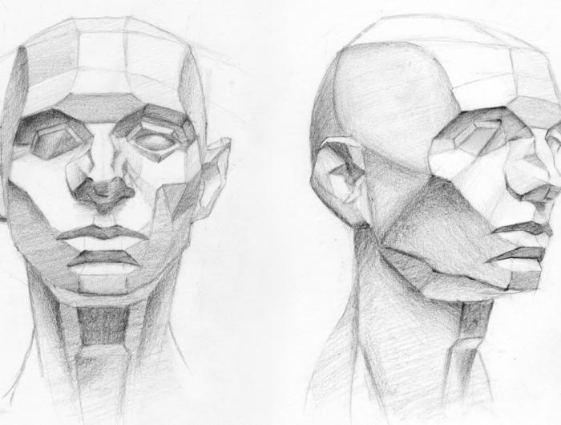
Questions
Perpetrator age.
Perpetrator gender.
Perpetrator race.

Slide 5


Data source
In this project we work on a dataset published on Kaggle.com, an specialized platform in data analysis.
This dataset is based on data collected by The Murder Accountability Project, the most complete database of homicides in the United States currently available.

Slide 6
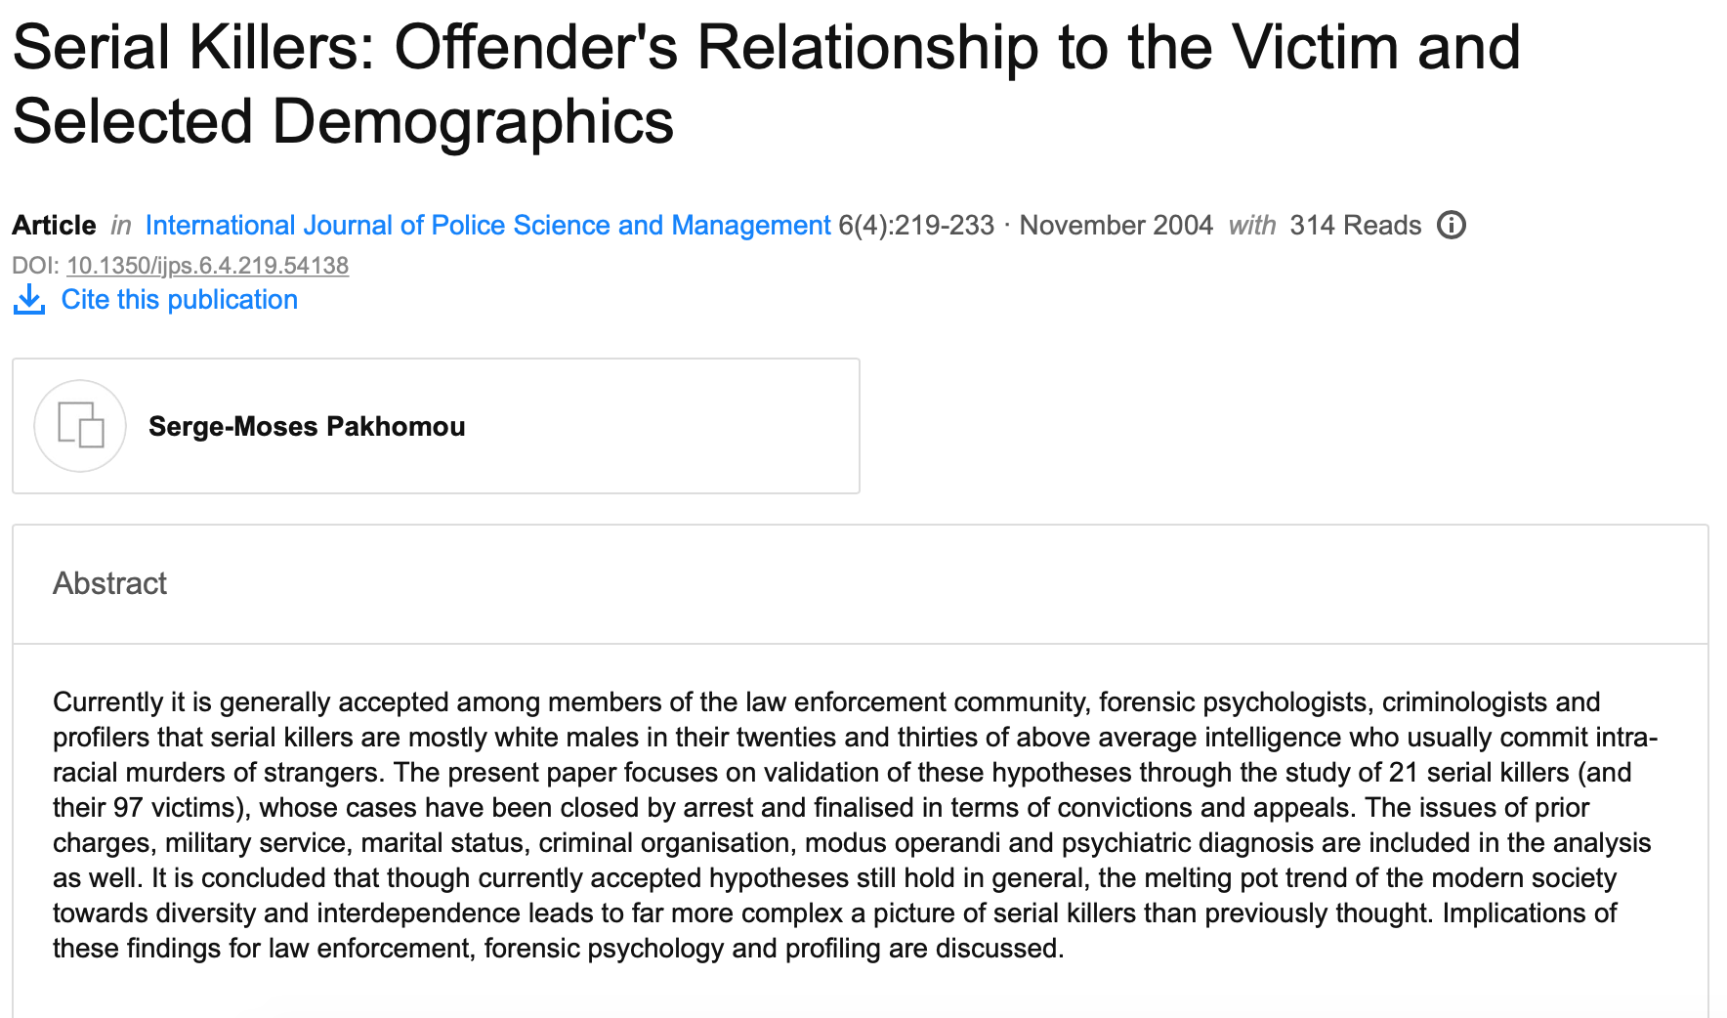
Profiling the Serial Killers - Steps

Slide 7
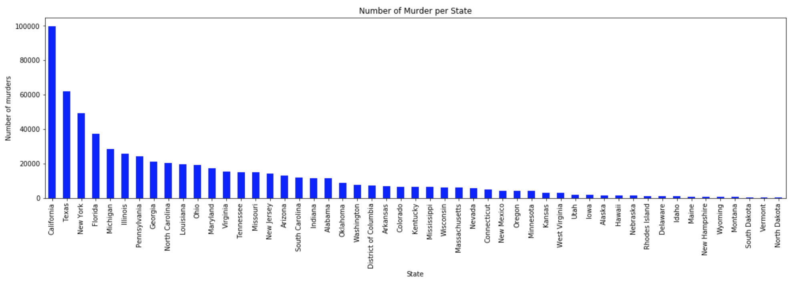
Profiling the Serial Killers - Steps
Step 1

Slide 8
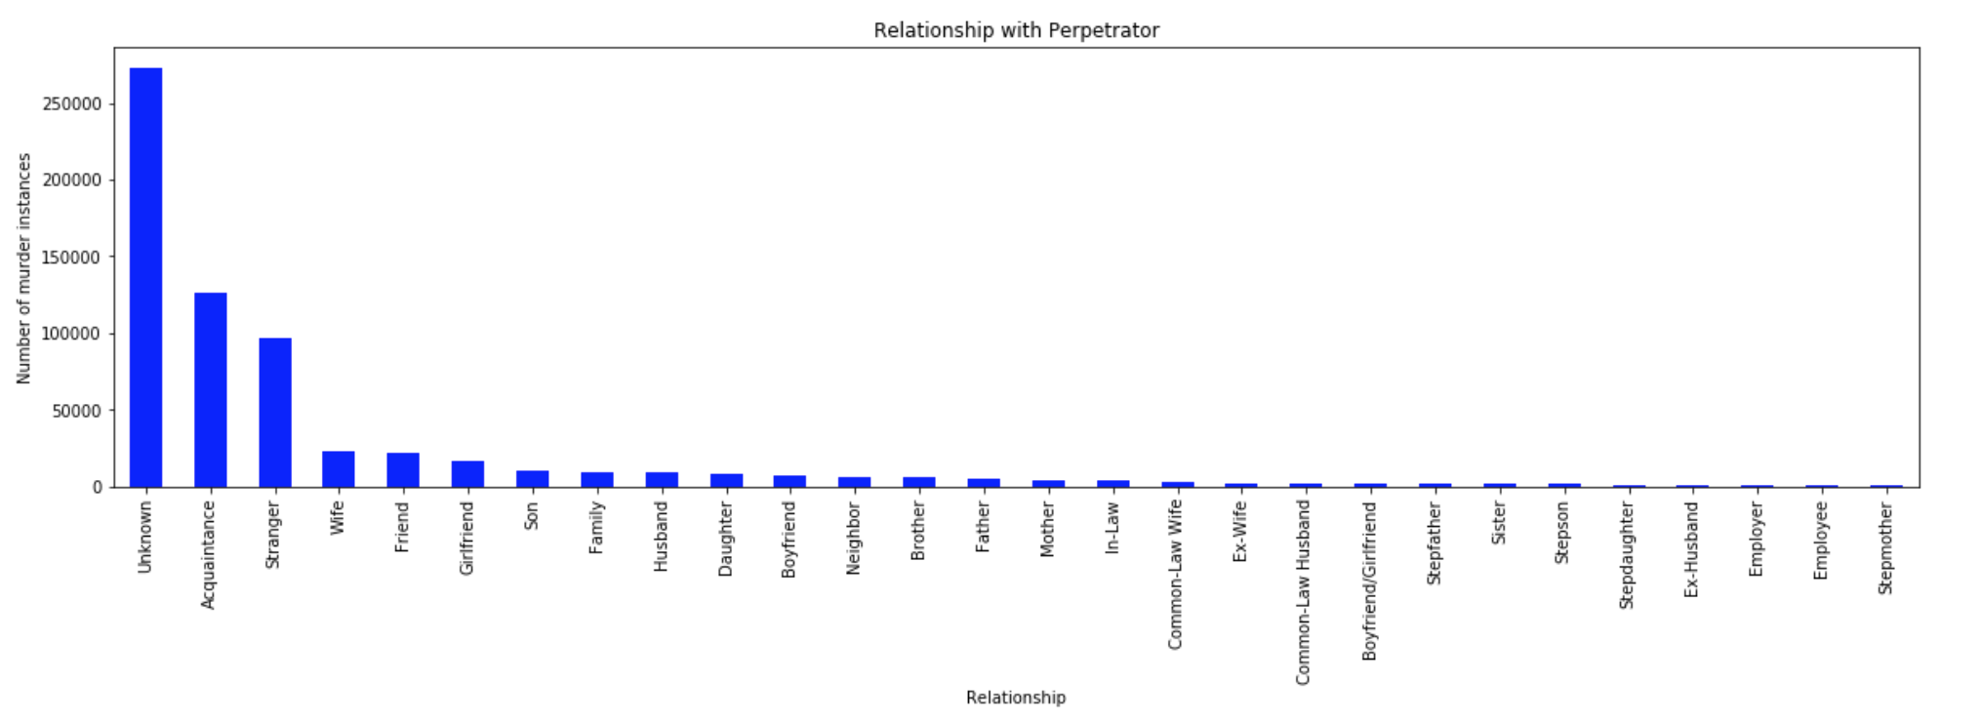
Profiling the Serial Killers - Steps
Step 2- Feasibility to profile serial killers

Slide 9
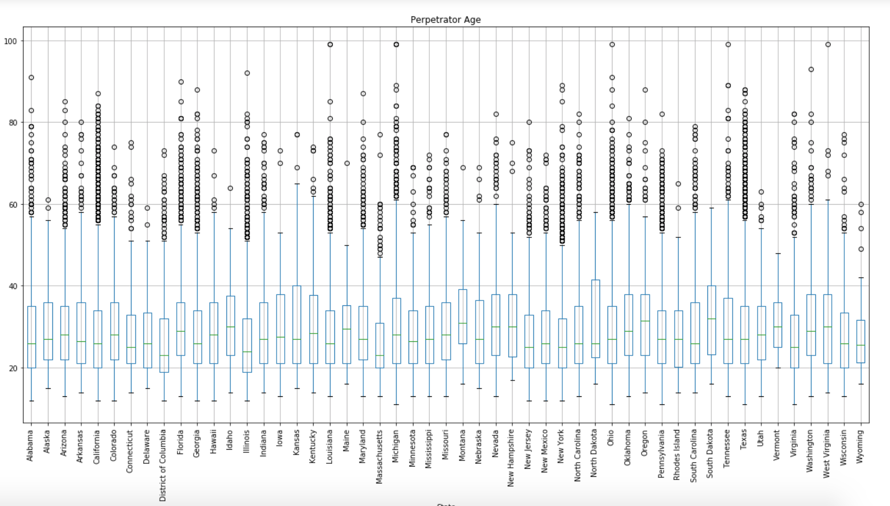
Profiling the Serial Killers - Steps
Step 3- Checking possible Outliers, and removing them

Slide 10
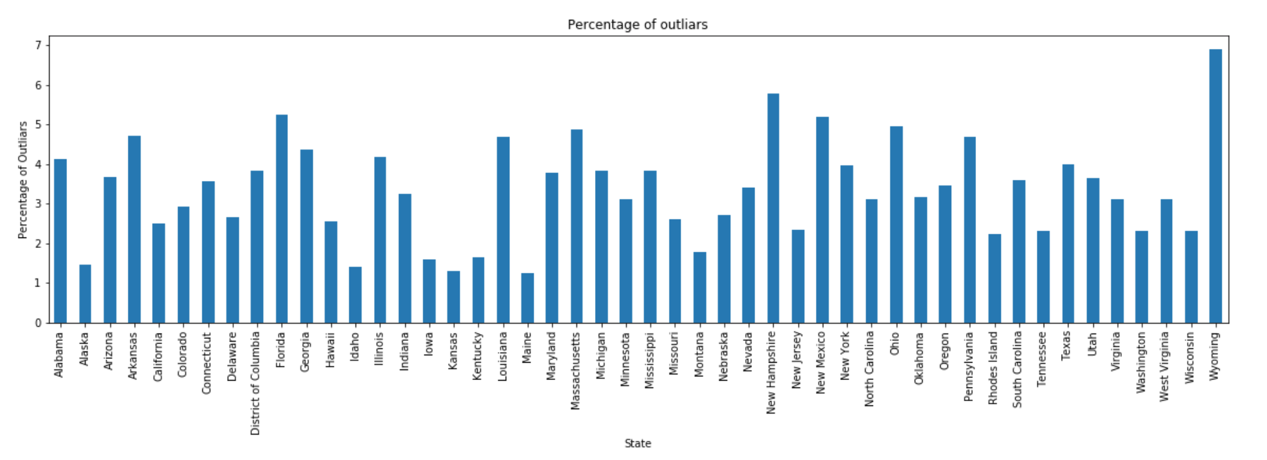
Profiling the Serial Killers - Steps
Step 4- Check percentages of Outliers

Slide 11
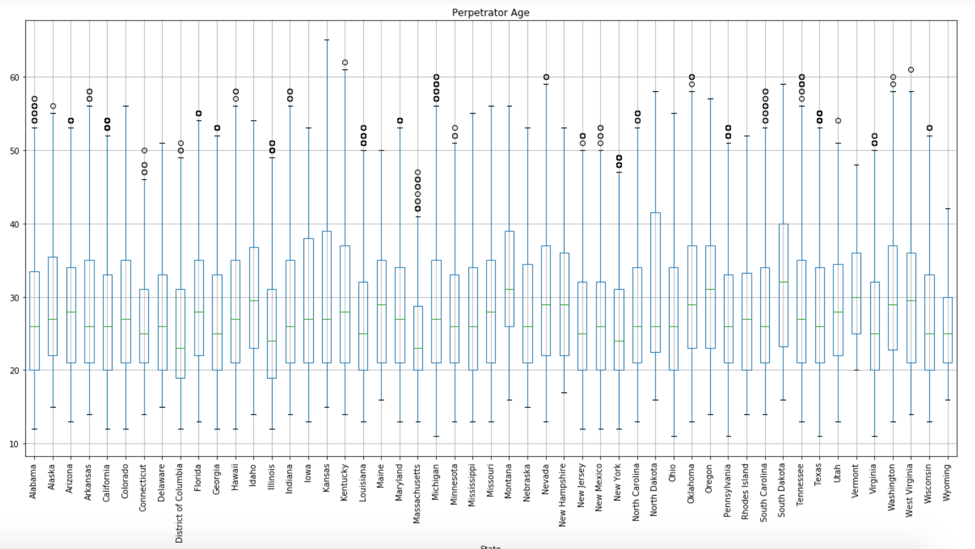
Profiling the Serial Killers - Steps
Step 5- Ages with removed outliers

Slide 12
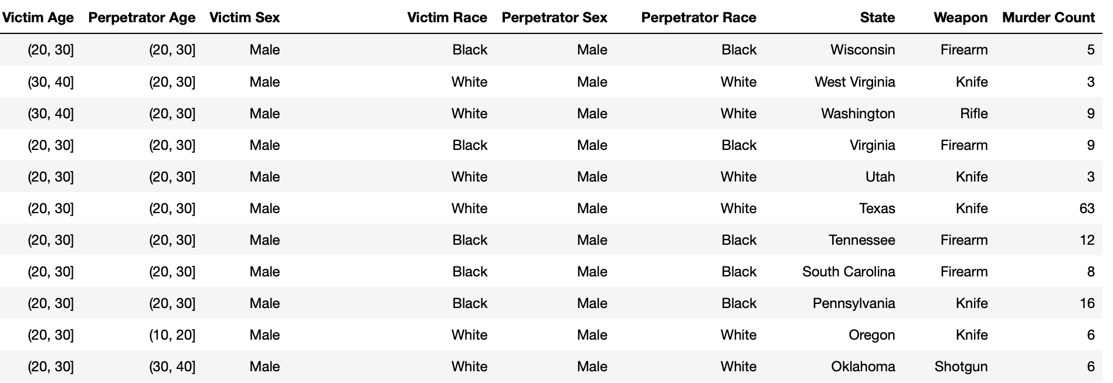
Profiling the Serial Killers - Results
Profiles

Slide 13
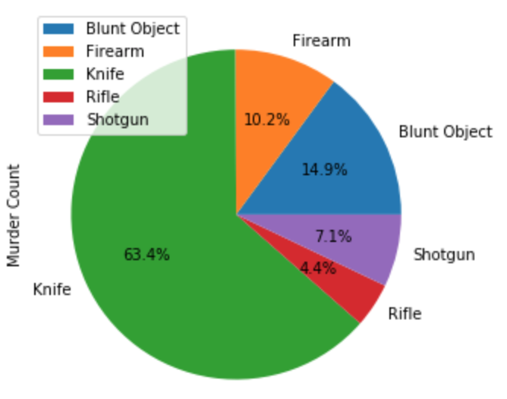
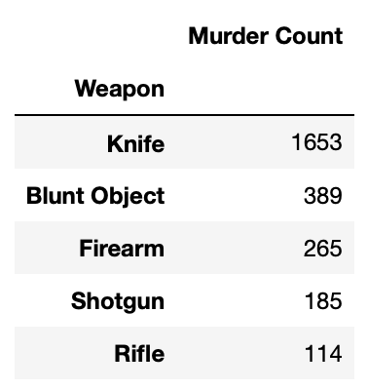
Profiling the Serial Killers - Results
Profiles- Preferred Weapon

Slide 14
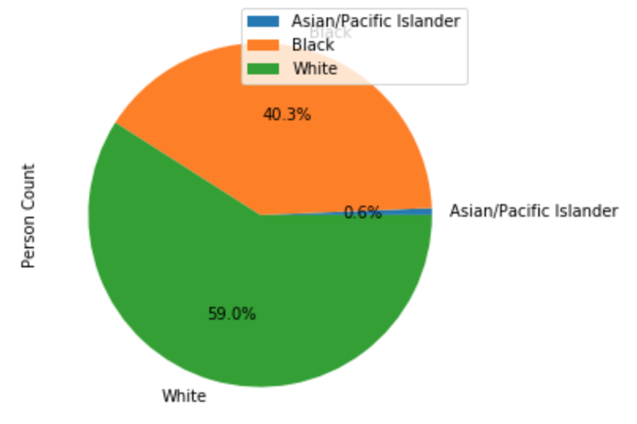
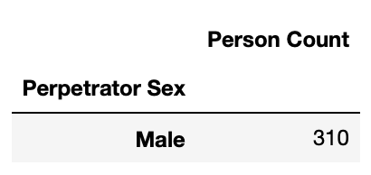
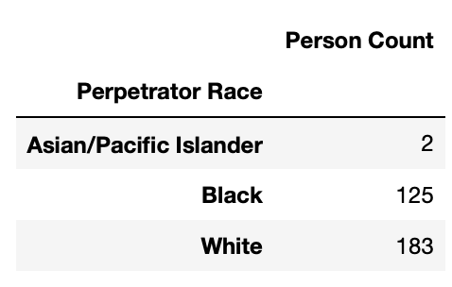
Profiling the Serial Killers - Results
Profiles- Perpetrator Sex, and Race

Slide 15
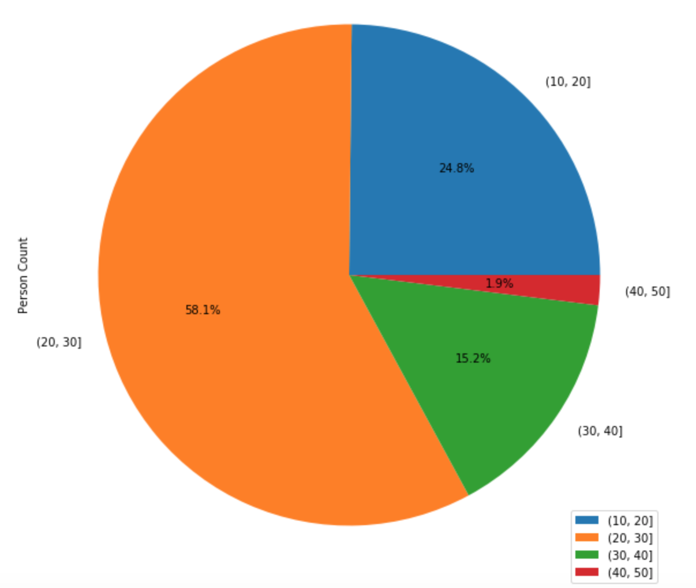
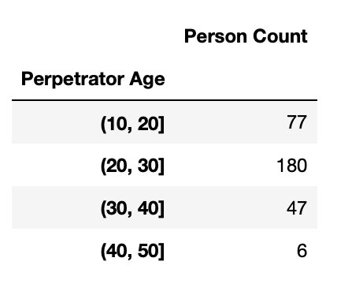
Profiling the Serial Killers - Results
Profiles- Perpetrator Age

Slide 16
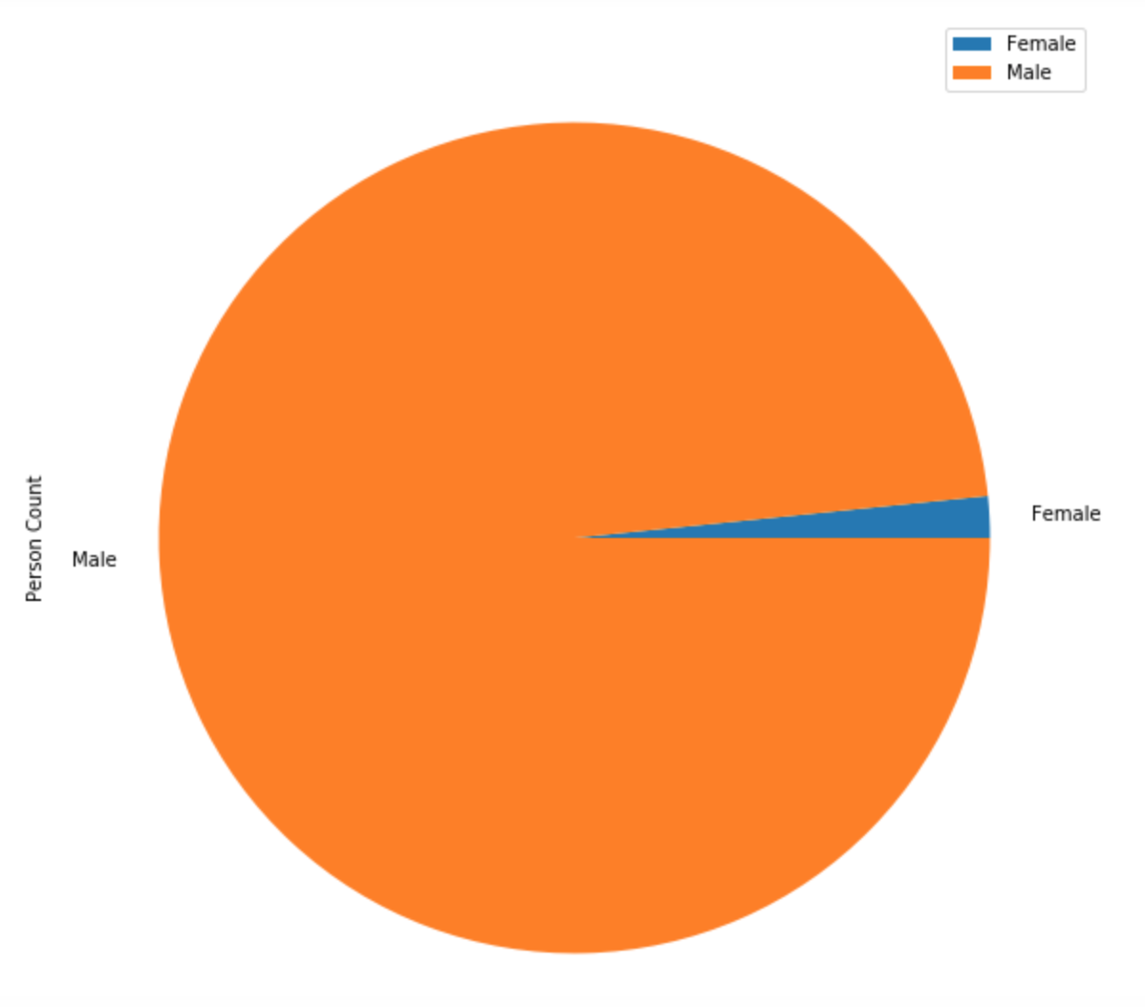
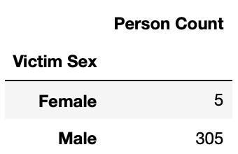
Profiling the Serial Killers - Results
Profiles- Victim Sex

Slide 17
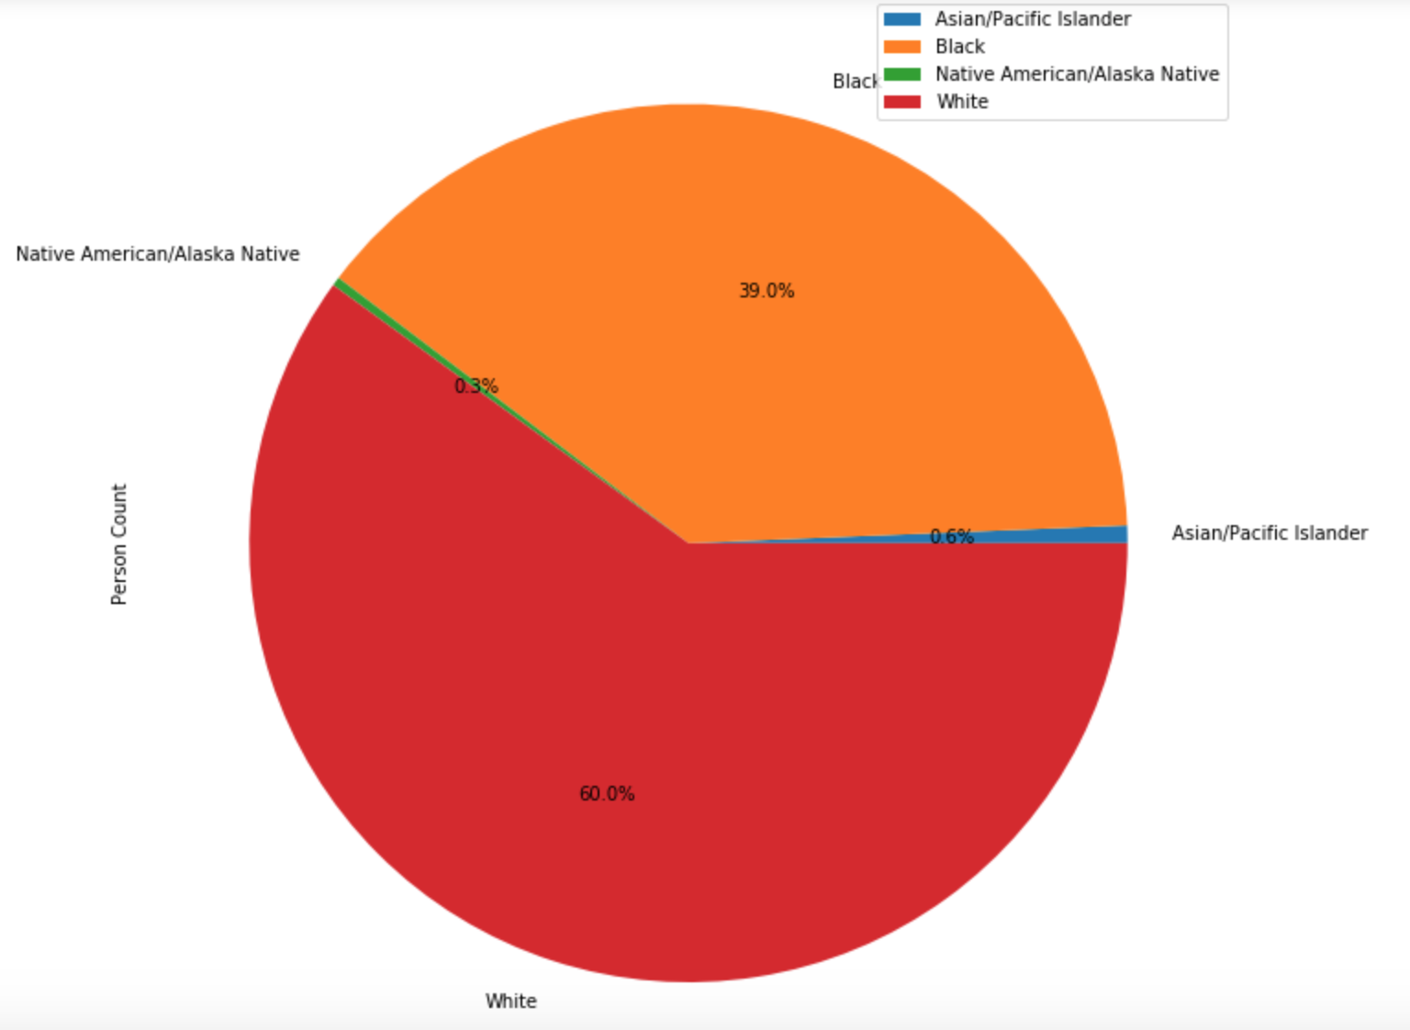
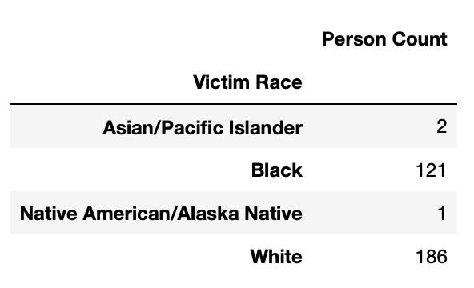
Profiling the Serial Killers - Results
Profiles- Victim Race

Slide 18
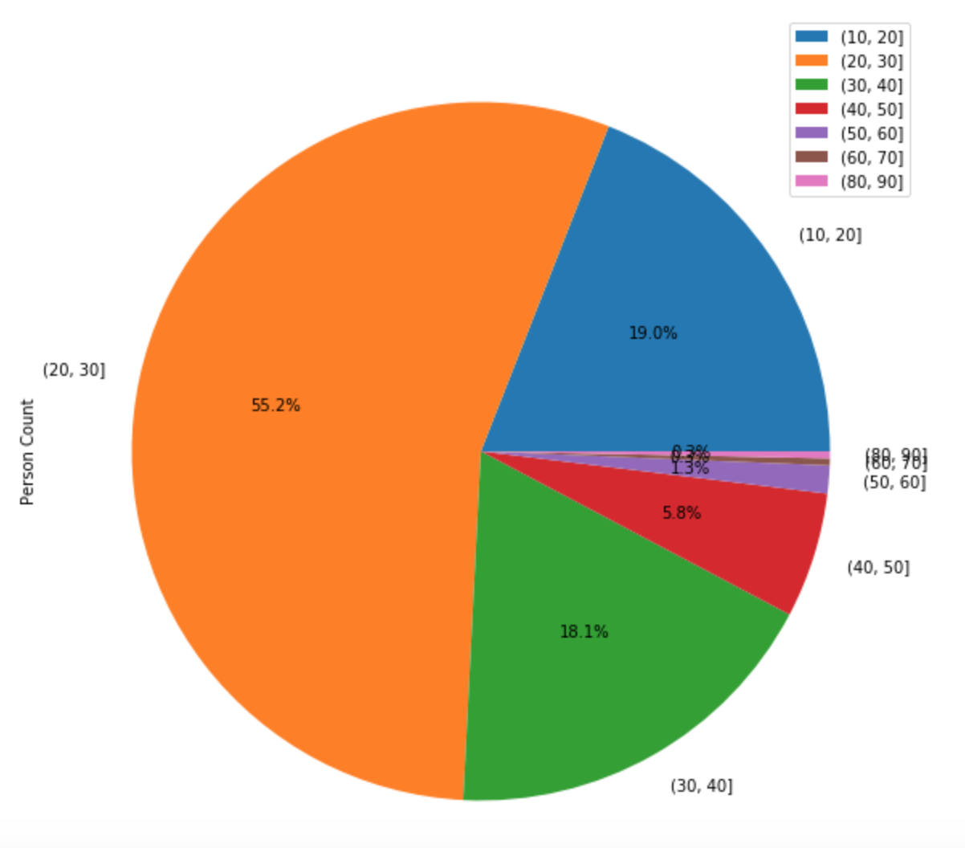
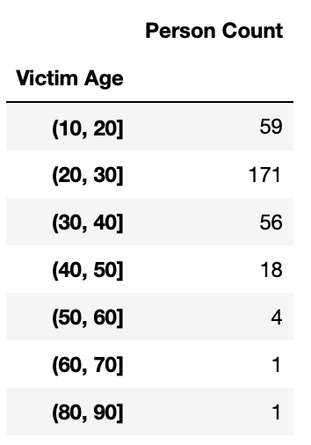
Profiling the Serial Killers - Results
Profiles- Victim Age

Slide 19
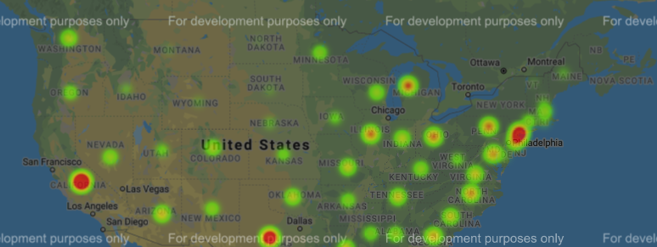
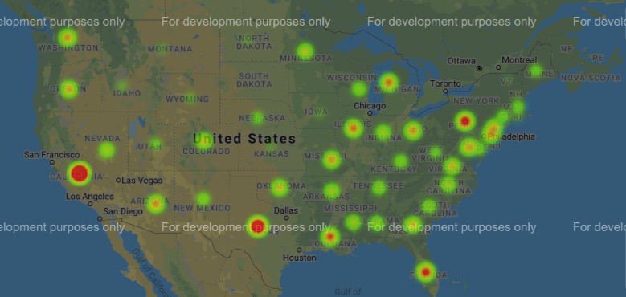
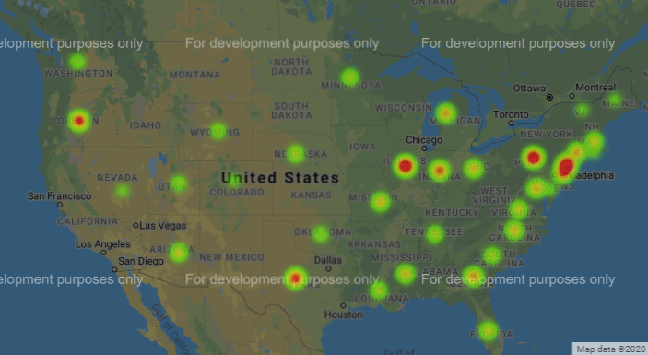
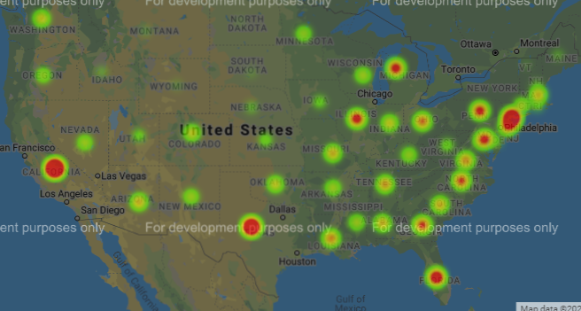
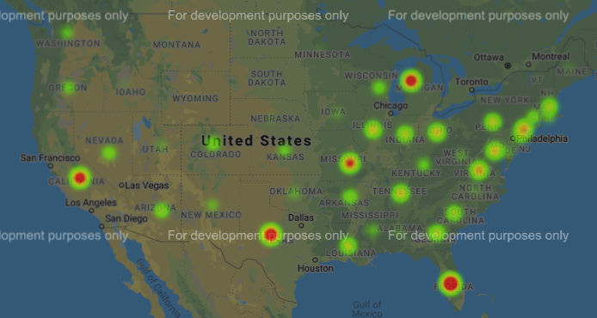
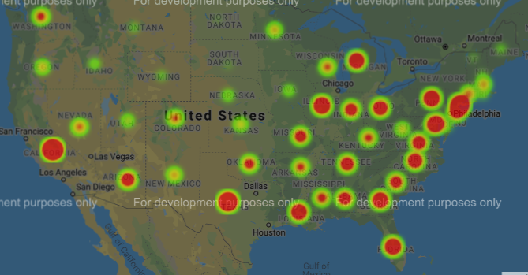
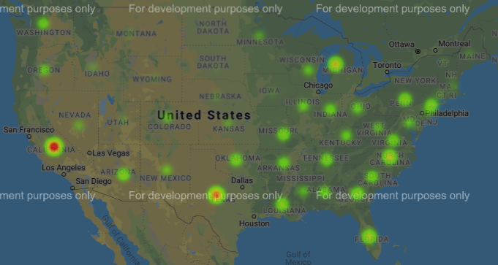
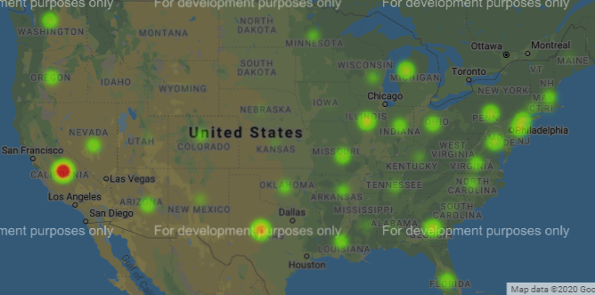
Weapon of choice by state (Heatmap)
Blunt object
Drowning
Fall
Knife
Firearm
Handgun
Rifle
Strangulation

Slide 20
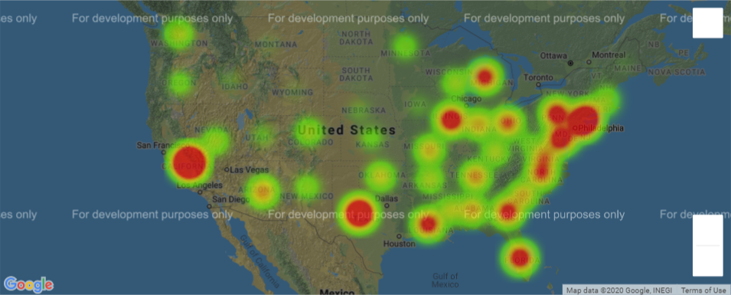
Homicides by handgun in the us by state

Slide 21
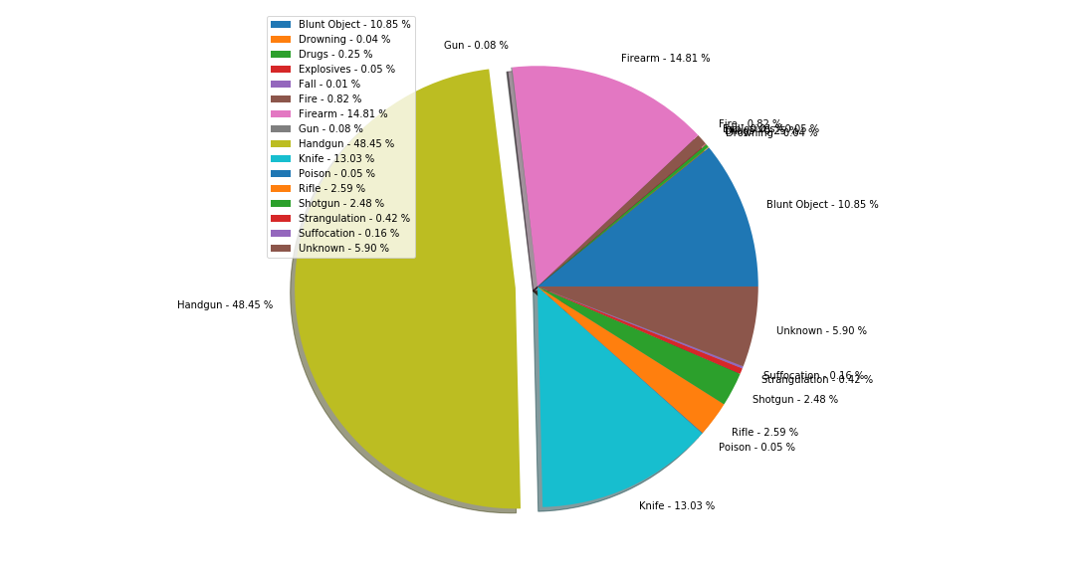
Types of weapons used and their distribution

Slide 22
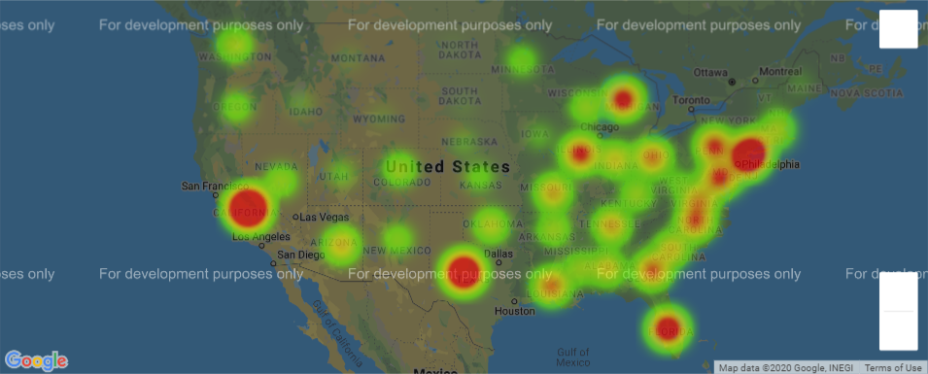
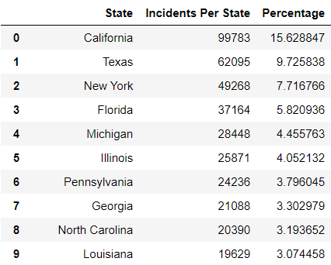
Number of homicides in us states and incidents during this period

Slide 23
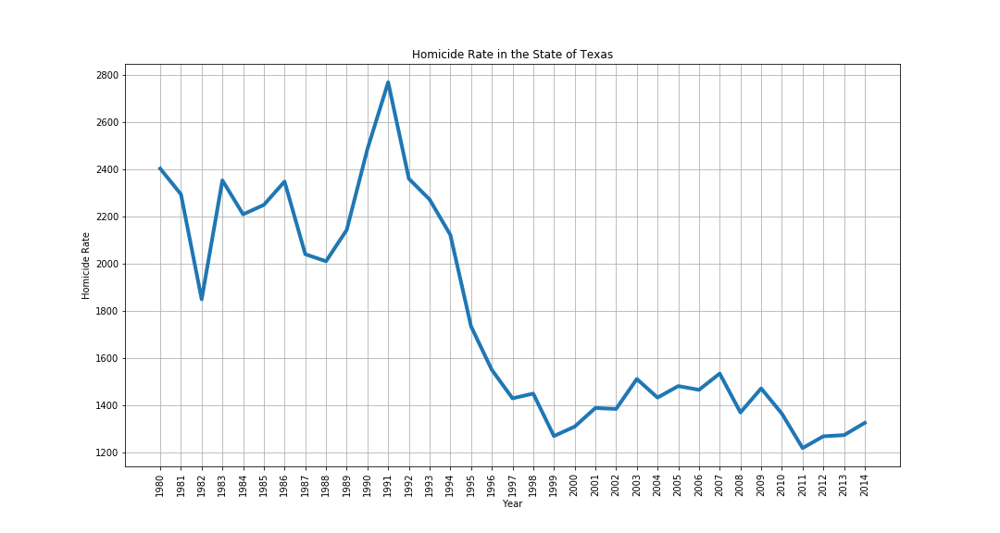
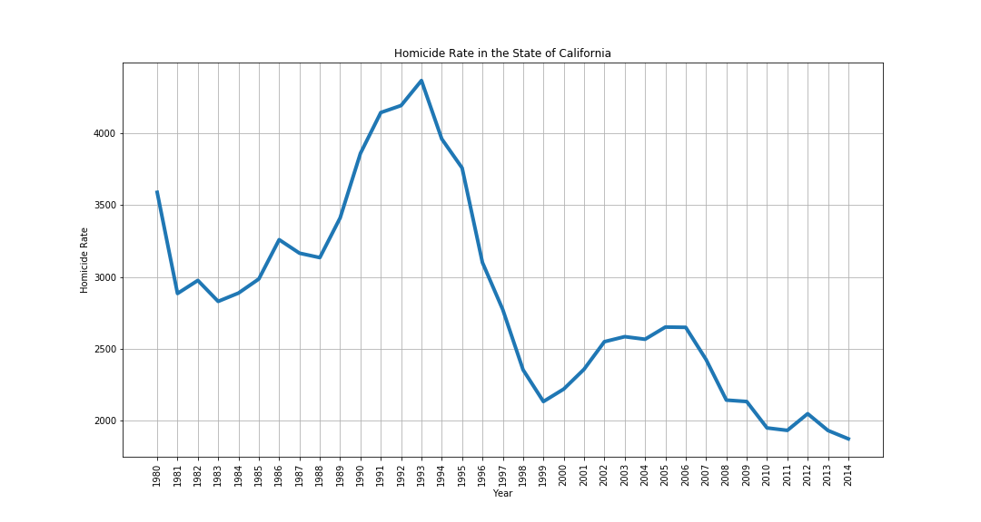
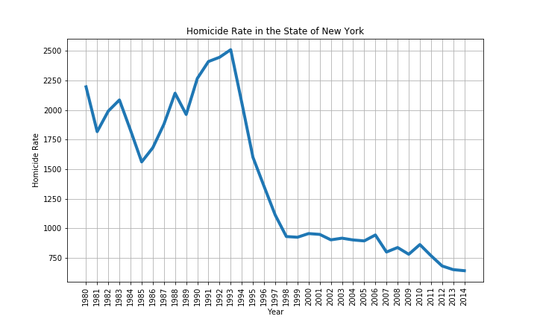
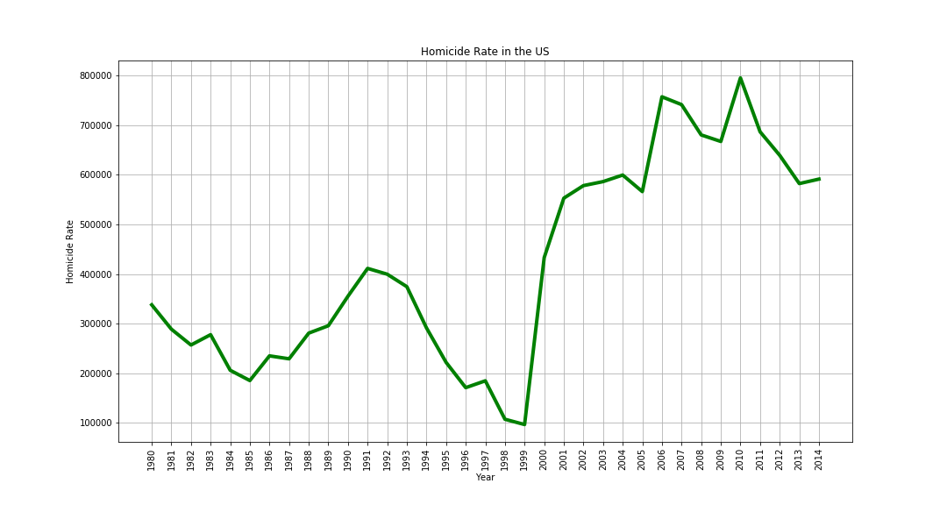
HOMICIDES COMMITED DURING 1980 - 2014

Slide 24
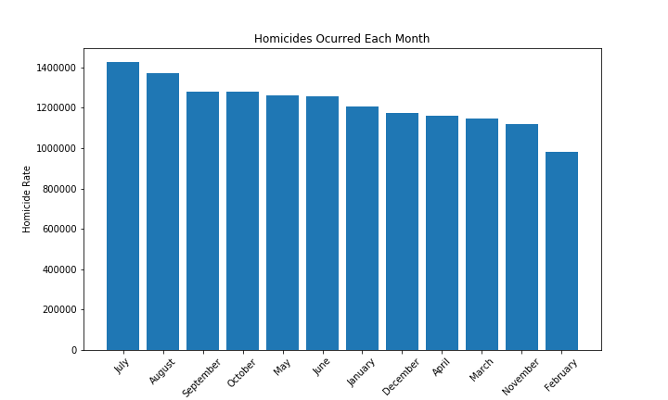
Is violent crime seasonal?

Slide 25

questions
¿What is the preferred weapon of choice per state?
¿What are the possible profiles for serial killers per state?
¿Are the serial killers white, male on their 20s-30s whom kill intra-race?

Slide 26

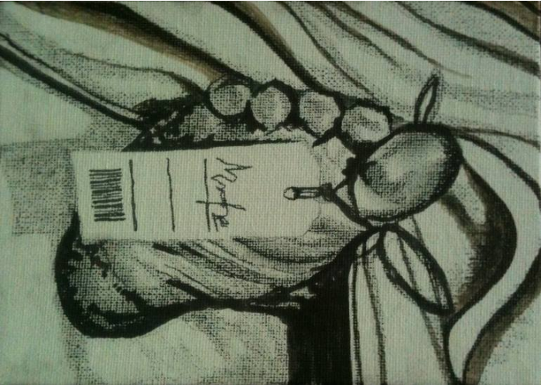
Post MORTEM
Difficulty was found in profiling the killers by city due to the large number of cities available in the data set.
Most victims came out males, we expected females.
Possible to make a classifier.
Further the profile researcher in periods of murders.

Slide 27

Gracias
Alejandro
Andrés
Mauricio

Slide 28
Reference
Pakhomou, S.-M. (2004, November). Serial Killers: Offender's Relationship to the Victim and Selected Demographics. Retrieved March 5, 2020, from https://www.researchgate.net/publication/247827058_Serial_Killers_Offender's_Relationship_to_the_Victim_and_Selected_Demographics
Project, M. A. (2017, February 10). Homicide Reports, 1980-2014. Retrieved March 1, 2020, from https://www.kaggle.com/murderaccountability/homicide-reports

